Slide 1
Speaker identification system
Reporter:Zhao Guixiao

Slide 2
Voice recording and segmentation
Speaker identification
Speaker clustering
Display and friendly interface
Notes:
语音录制和分割
说话人识别
说话人聚类
显示和友好界面设计

Slide 3
Voice recording and segmentation
Acquire voice information in real time through a microphone. During the acquisition process, the voice format is set to mono, 16000hz sampling rate, and 16-bit sampling digits. The file format is .wav
Audio recording can be achieved by the recorder or by using the audiorecorder function. The recorded audio is saved in the specified folder for easy recall.
Notes:
通过麦克风采集实时的音频信息，在采集过程中，设置语音格式为单声道，16000hz采样率，16位采样位数。文件格式为.wav
音频录制可通过录音器或利用audiorecorder函数来实现，录制好的音频保存在指定文件夹下，方便调用。

Slide 4
Voice recording and segmentation
The most commonly used method of speech segmentation is a dual threshold method based on short-term energy and short-term zero-crossing rate.
The algorithm can better remove the long mute segment and the noise segment in the preprocessed speech, and obtain the speech segment that needs to be analyzed.
Notes:
语音分割方法中最常用的是基于短时能量和短时过零率的双门限方法。
短时能量是度量语音信号幅度值变化的函数。
短时平均过零率是指一帧语音中语音信号波形穿过零电平（横轴）的次数
该算法能较好的去除经过预处理后的语音中的较长静音段和噪音段，获得真正需要分析的语音片段。

Slide 5
Speaker identification
Deep Convolutional Network (CNN) is used for speech feature extraction and speaker identification.
The network structure is based on VGG-M, and some modifications have been made on this basis.
A fully connected layer with a dimension of 9*8 is transformed into a fully connected layer with a dimension of 9*1 and an average pooling layer with a dimension of 1*n.
Notes:
采用深度卷积网络（CNN）用以语音特征提取和说话人识别。
网络结构是基于VGG-M，并在此基础上做了一些修正。
将网络中维度为9*8的全连接层转换为了一个维度为9*1的全连接层和一个维度为1*n的平均池化层。（1*n的平均池化层保证网络可以以任意长度的语音作为输入）

Slide 6
Speaker identification
fully connected fc6 layer
dimension 9*1
fully connected fc6 layer
dimension 9*8
an average pool layer
dimension 1*n

Slide 7
Speaker identification
Input: The segmented audio data is slid over the audio spectrum with a certain window length and window shift to obtain the speech spectrum feature as an input to the entire network.
Output: The output is the score of the speech of and the label information of the corresponding speaker.
Notes:
对经过分割后的音频数据，以一定的窗长和窗移在音频频谱上滑动获得声谱特征，作为整个网络的输入。
输出为该段语音的得分和对应说话人的标签信息。

Slide 8
Speaker identification
Training strategy:The training is based on the deep learning toolkit MatConvNet. The training of the network uses a batch standardization method. The required parameters (weight, attenuation, learning rate) are provided by the toolkit.
The beginning is to use softmax to pre-train the weight of the initial network to carry out multi-category training, and then fine-tune the model.
Notes:
训练策略：训练基于matlab上一个深度学习工具包MatConvNet，网络的训练采用批量标准化的方法，所需参数（权重、衰减、学习率）都由工具包提供。
训练初始阶段是利用softmax进行预训练，初始化网络的权重，进行多分类任务的训练，然后对模型进行微调。之后便可用于识别任务。

Slide 9
Speaker identification
Loss function: uses cross entropy loss with softmax function.
The trained spectrograms is mapped to a compact European space, and the distance metric is used to assess the similarity between speakers.
Identification: Due to the presence of the average pooling layer fc6, speech of any length can be tested during the test phase and can be evaluated at one time.
Notes:
损失函数使用具有softmax函数的交叉熵损失.
训练好的语音频谱会映射到一紧凑的欧式空间，距离度量用来评估说话人之间的相似性。
在识别过程中，由于平均池化层fc6的存在，在测试阶段可以测试任意长度的语音，并且可以一次评估。
训练用数据为1251人，100000条语句。

Slide 10
Speaker identification
The first step is to design a "compilation environment" interface to ensure that the identification process runs in the right environment.
The second is to design a real-time incoming interface for voice files and a real-time updated output interface.
Finally, the output speaker tag and corresponding speech segment are saved in order.
Notes:
该模块的设计：
首先要设计一个“编译环境”的接口，用来保证识别过程运行在正确的环境下。
其次是设计一个语音文件的实时传入接口和一个实时更新的输出界面（显示界面）。
最后要将输出的说话人标签和对应语音段按顺序保存，方便后来的调用（还要实时保存）。
如何依次输入语音段，依次保存。

Slide 11
Speaker clustering
The speaker clustering module is designed to bring together identified speech segments belonging to the same speaker for easy recording.
Commonly used clustering algorithms include k-means clustering, spectral clustering and k-nearest neighbor algorithm. Here, k-nearest neighbor algorithm is used as speaker clustering.
Notes:
说话人聚类模块的设计目的是为了将已识别好的属于相同说话人的语音段聚集到一起，便于记录。
常用的聚类算法有k均值聚类，谱聚类和k近邻算法，这里采用k近邻算法用于说话人聚类任务中。

Slide 12
Speaker clustering
In the design of the module, the input interface of a speech segment is first designed.
In addition, you need to add a setting interface for the number of speakers.
The display interface is used to display the results of the cluster and can be updated in real time.
The output file is saved in a fixed format in the specified folder.
Notes:
在该模块的设计中，首先要设计一个语音段的输入接口。
此外，要添加一个说话人数目的设置接口。
显示界面用来显示聚类的结果，并能实时更新。
输出文件按固定格式依次保存在指定文件夹下。（标签+语音段的标签）

Slide 13
Display and friendly interface
The display module includes three parts, which respectively display the voice waveform and the corresponding number, the recognition result and the clustering result.
A prompt module at the beginning and end of each process.
The process runs the wrong prompt module and returns a prompt. There is also an interface to reset the system.
Notes:
显示模块包括三部分，分别显示语音波形和对应编号，识别结果和聚类结果。
此外，在各进程开始和结束时的提示模块。
进程运行错误的提示模块和返回提示。此外还要有一个系统错误后重置系统的接口。

Slide 14
Display and friendly interface
Dialogue style choices are used in the interface design, plus user access and control mechanisms.
The four modules can be operated independently or in combination,。Consider the synergy between the four modules
Consider portability and whether it works properly in a new work environment.
Notes:
在界面设计中要使用对话风格的选择，并加上用户存取和控制机制。
四个模块既可独立运行，又可联合运行。考虑四个模块之间的协同合作。(并不是单纯的相加，各个模块可以独立运行)。
考虑可移植性，可迁移性，保证在新的工作环境下是否可以正常运行。

Slide 15
System Block Diagram
Speech
recording
compilation environment
Input
Speech
segment
Input
Speaker
clustering
Display
Speaker
identification
Display
Save file
Display
Result
Result
Save file
Save file

Slide 16
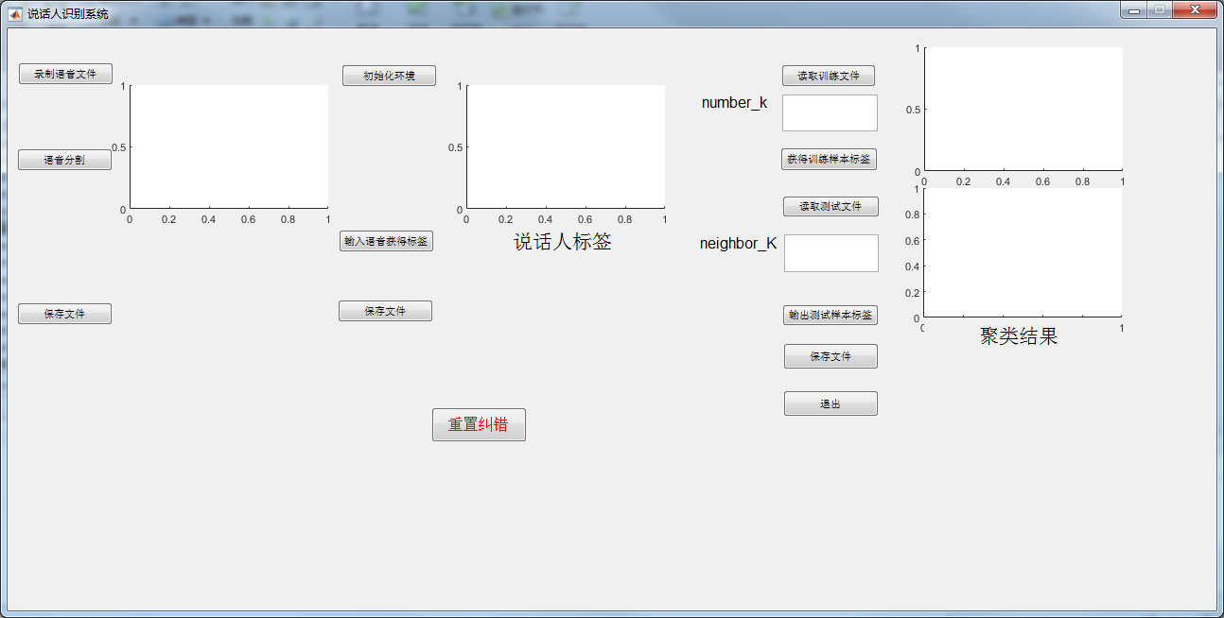
Notes:
接下去的工作，主要还是首先将实验做的更完整充分一些，包括直接从一些视频中随意截取语音进行测试。然后是对训练好的模型的调整。
另一方面是在软件设计这一方面。

Slide 17
Thank You

